Slide 1

Smart Meters in London: Understanding Energy Consumption and Estimating Cost Savings

Slide 2
The Data
The City of London collected energy usage data through household smart meters
The study divided categorized households by ACORN, based on various demographic characteristics
The ACORNS were divided into three major income-based categories: Affluent, Comfortable and Adversity
The data was posted, along with matching weather data, to https://www.kaggle.com/jeanmidev/smart-meters-in-london

Slide 3
The purpose and value of this data
Forecasting energy usage can reduce waste – energy can be produced and distributed based on actual need
By studying the segments, utilities can predict changes in energy consumption based on income level
The city can understand the impact of temperature on energy usage
Consumers can understand usage patterns and identify opportunities for savings
The data can serve as a benchmark for programs seeking to decrease average household usage and use the model to calculate savings

Slide 4
Data Wrangling
I combined the daily household records through a glob function
I created and then concatenated pivot tables to calculate average usage per day and per group, which I stored in a data frame
For each group, I created a column with a 365-day shift
This served as a naïve model – forecasting that a given day’s energy usage in the test set is equal to the usage 365 days prior
I used this to calculate 365-day difference; the new differenced time series were stationary
I used the differenced time-series in the models

Slide 5
Exploratory Data Analysis
Most data was available – for the missing values, I used forward filling
From descriptive statistics and from plotting, there are obvious differences in usage patterns:
Affluent uses the most
Comfortable usage is comparable to overall average
Adversity uses the least

Slide 6
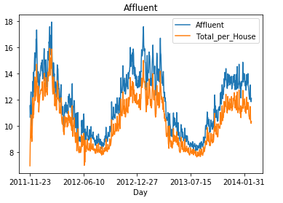
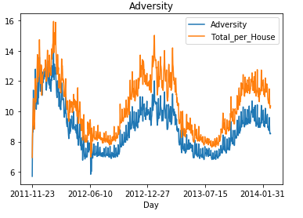
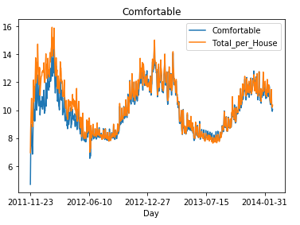
Energy Usage per Income Group

Slide 7
Checking Stationarity
I used the Augmented Dicky Fuller test for stationarity
Stationarity, defined as stable mean and variance over time, is required for time series analysis
None of the 4 series were stationary before differencing
After differencing by 365 days, 3 series were stationary with an alpha of 0.05 and the other series was stationary with an alpha of 0.10

Slide 8
Modeling
I ran grid searches for each model for each series to minimize Bayesian Information Criteria (BIC) on the following parameters:
p – the number of lags in an autoregression
d – the number of differences taken
q – the number of elements in a moving average
P – the number of lags in the seasonal autoregression
D – the number of differences for season
Q the number of elements in the seasonal moving average

Slide 9
Modeling
After finding optimal parameters I fit models for each of the following for the 365-day differenced series:
Seasonal Autoregressive Integrated Moving Averages with exogenous variable (SARIMAX)
Seasonal Autoregressive Integrated Moving Averages with no exogenous variable (SARIMA)
Autoregressive Integrated Moving Averages with exogenous variable (ARIMAX)
I undifferenced the forecasts and calculated the Mean Average Error (MAE) against the test sets
I compared the results to the MAE of the naïve model (forecasting a day’s usage based on the usage 365 days prior)

Slide 10
Best model – SARIMAX
Comparing each model by Mean Average Error, SARIMAX showed the best overall performance
 | Total Population | Affluent | Comfortable | Adversity
SARIMAX | 0.56 | 0.65 | 0.58 | 0.46
SARIMA | 0.70 | 0.89 | 0.67 | 0.47
ARIMA | 0.56 | 1.72 | 0.52 | 1.43
NAÏVE | 0.71 | 0.90 | 0.67 | 0.50

Slide 11
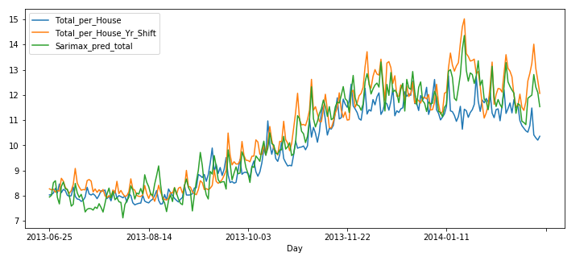
SARIMAX prediction compared to test set and naïve model

Slide 12
Simulating cost savings
I created a function to calculate the savings based on energy efficiency measures
The user enters:
Average cost per kilowatt over period
Time series of usage before and after an energy use change was implemented (e.g. new appliances purchased)
Time series of average temperature data
The date of the implementation
The forecast uses the optimized parameters per income group for the SARIMAX model to train on all data prior to date of implementation
The function calculates what would be expected given temperature after implementation, subtracts the true values, sums the differences and multiplies that sum by the average cost per kilowatt to give total cost savings

Slide 13
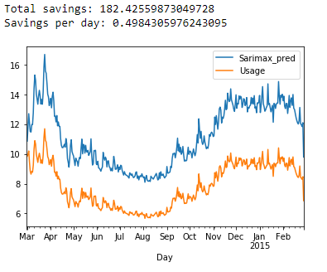
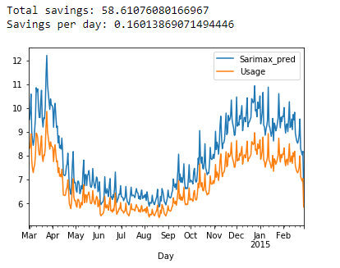
Simulation of 25% energy improvement over the course of one year for:
Affluent Comfortable

Slide 14
Takeaways
There is opportunity for saving money and reducing consumption – especially for the Affluent group
The City of London can use visualizations with estimated money saved to empower consumers and inspire change

